Slide 1
Oscar Renalias
Getting started with Node.js
October 11, 2013

Slide 2





About me
@oscarrenalias
github.com/oscarrenalias
oscar.renalias@accenture.com
oscar@renalias.net

Slide 4
Server-side

Slide 5

Javascript
Dynamically typed
Supports functions/closures
Object-oriented with prototype-based inheritance
Standardized as ECMAScript

Slide 6

V8: High Performance JavaScript Engine
JIT to native: x86, ARM and MIPS
On-the-fly recompilation of “hot” functions with an optimizing compiler
ECMAScript compliant

Slide 7
Single threaded??
Notes:
Unashamedly inspired by: http://www.slideshare.net/sergimansilla/big-app-design-for-nodejs (slide 11)

Slide 8
Asynchronous, Event-based
Event
Event producers
Event
Callbacks
Event
Loop
Event

Slide 9
Single threaded, asynchronous, event-based!
Callback ready
Wait for callback
Wait for I/O
Wait for I/O
Notes:
Other approaches to deal with application parallelism:
One thread per connection – there is an upper limit to the number of concurrent threads, and there is a memory overhead per thread
Fork a new process per connection – same as above; limited by the operating system process scheduler, and processes are heavier than threads
Synchronous – don’t bother with parallel processing
Node.js’ approach to parallelism scales better and uses less memory to process a larger amount of connections – but it requires that we build applications that are not CPU-bound

Slide 10
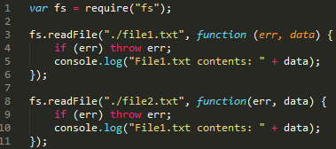
Event callbacks

Slide 11
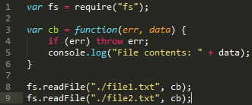
Sequential callbacks?

Slide 12
So why are async and events good?
Easier to write
Scales better
Lower memory, CPU overhead

Slide 13
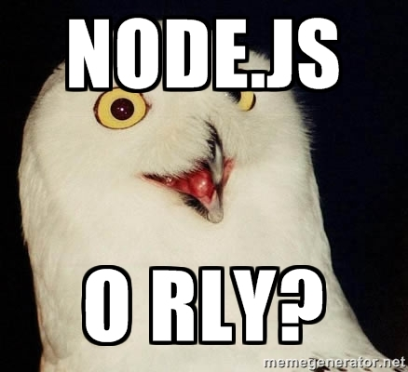

Slide 14
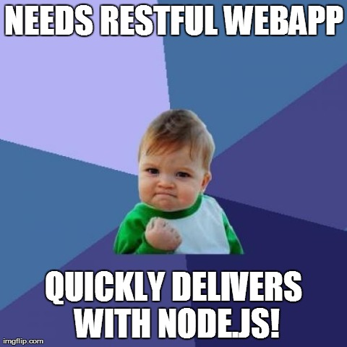
Rapid prototyping, rapid development

Slide 15
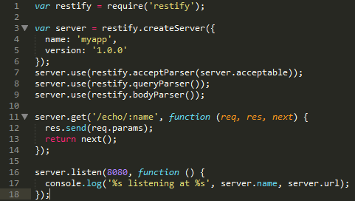
RESTful services with no effort
Notes:
Node-restify is used here, but it can all be accomplished without a framework too.

Slide 16
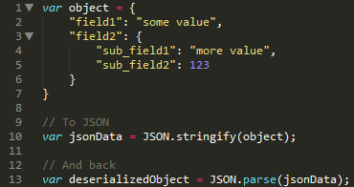
No-fuss, native JSON handling
Notes:
JSON is Javascript’s native serialization format
Integrates very well with things like JSON-based APIs, MongoDB, etc – things that speak JSON natively

Slide 17

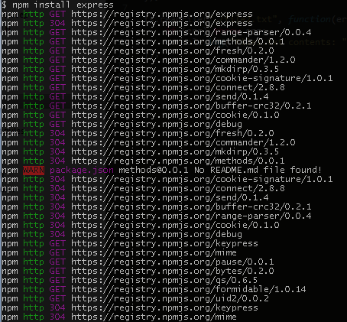
Awesome Package management
Gets out of the way
Support for internal and public modules
Kiss problems with transitive dependencies goodbye

Slide 18
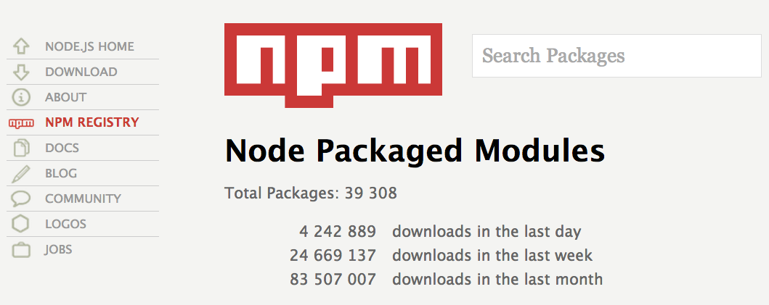
Community modules
http://npmjs.org

Slide 19
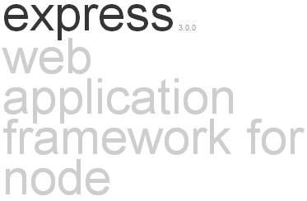
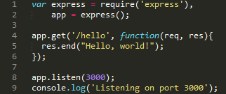
Interesting Projects: Express
Minimal web application framework
Additional features are provided as modules or middleware: template engines, models, authentication and authorization, etc

Slide 20
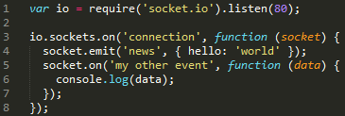
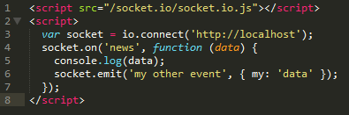
Interesting Projects: Socket.io
Provides support for server-initiated push events using WebSockets, Ajax polling, Iframe, JSONP or Flash-based channels
Transparent for both clients and servers
Can run standalone or integrated with Express
SERVER
CLIENT

Slide 21
Interesting Projects: Meteor
Next-gen framework for real-time collaborative web applications
Live page updates
Support for offline databases with subsequent synchronization
Notes:
http://www.meteor.com

Slide 22
When to use Node.js
REST+JSON APIs
Backend for single-page web apps: same language in client and server
Real-time web apps with Socket.io and Meteor
Quick prototyping
Rapidly evolving applications: media sites, marketing, etc

Slide 23
When not to use Node.js
CPU-bound tasks
Multi-threaded applications
Applications that have to process large amounts of data
Boring CRUD-type web apps
Notes:
Note on “boring CRUD-type web apps”: Node.js frameworks don’t make it neither easier nor more difficult to write traditional web apps; Node.js and its frameworks just simply make no difference here

Slide 24

Ready for the Enterprise?
Notes:
Image credit: http://www.allmystery.de/i/bk33NhA_ayZYgl_USS_Enterprise_NCC_1701_A_by_cb93.jpg

Slide 25
Maturity
Under development since 2008
Node.js 1.0 around the corner
Nearly 40000 modules available via npm
Awesome community
Commercial support
Notes:
https://groups.google.com/d/topic/nodejs/9afurRCTlOc/discussion

Slide 26

Lightweight Architecture Enabler

Slide 27
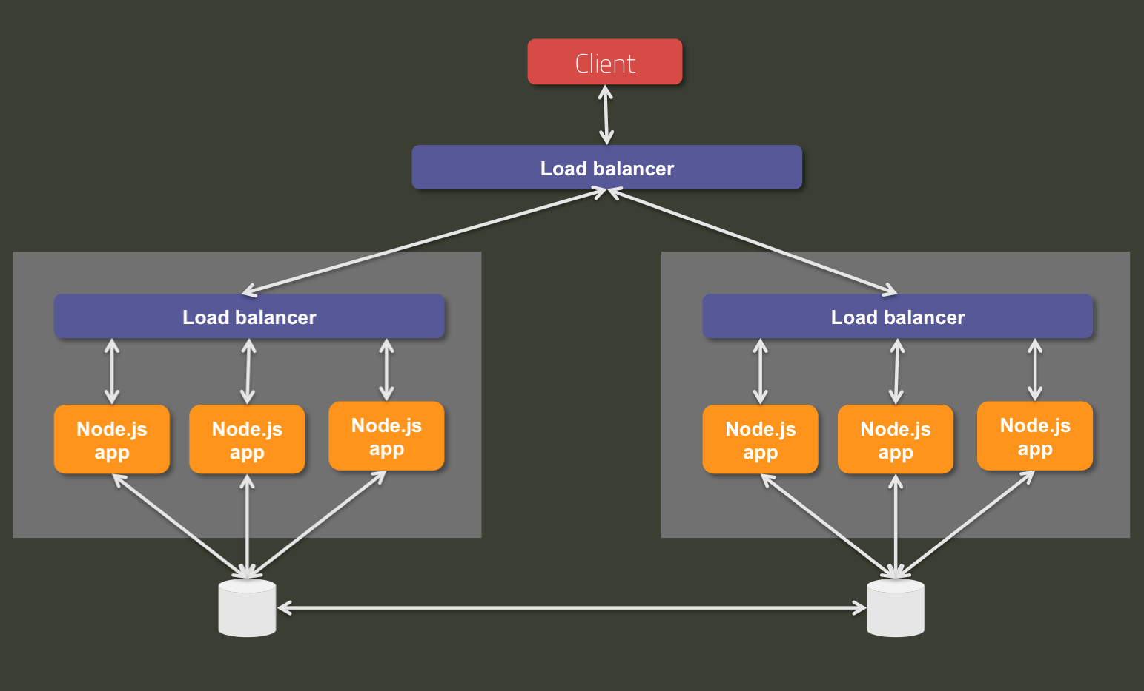
Does it Scale?
Notes:
Note: Diagram inspired from http://www.slideshare.net/BenLin2/webconf-nodejsproductionarchitecture
Node.js processes are single threaded so scalability within the same server is dependent on the number of node processes that we run.
In order to load balance the load within the same server, we can use a traditional load balancer running locally.
The next step is to scale multiple servers, for which we need an additional load balanced layer on top of the local instances.
Database/storage tier can be scaled according to the type of solution in use.

Slide 28
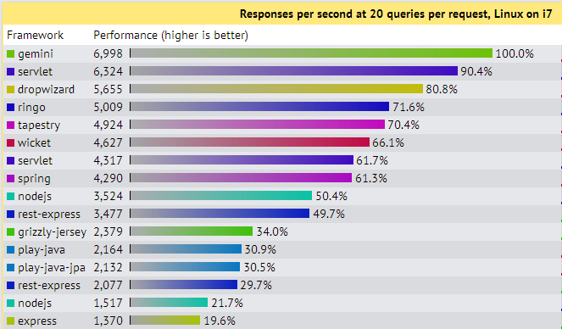
Performance
Test: multiple database queries per request, serialized as JSON responses
Source: http://www.techempower.com/benchmarks/

Slide 29
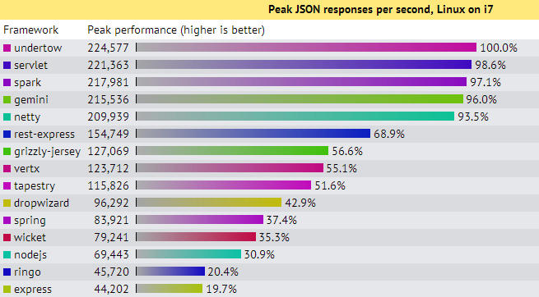
More Performance
Test: return a response as a simple serialized JSON object
Source: http://www.techempower.com/benchmarks/

Slide 30

Not the fastest; does it always matter?

Slide 31

Javascript
Like Java, with simple syntax and no types
Weird shit
Notes:
Image source: http://drtom.ch/talks/2012/06/jazoon/images/tip_of_the_iceberg.jpg
Original idea: https://speakerdeck.com/anguscroll/the-politics-of-javascript

Slide 32
JavaScript is quirky different
Prototype-based inheritance
“==“ versus “===“
The meaning of “this”
Call, apply and bind in Function.prototype
And more.
Notes:
JavaScript is not better or worse than other languages; but it may look more accessible and easier to learn than it actually is.

Slide 33


Solid development toolset
Notes:
Grunt = Ant, Maven
Yeoman = Maven, some parts of it including archetypes (“generators” in Yeomanese)

Slide 34
Toolset
Large selection of testing libraries: unit testing, functional testing, BDD
Static code analysis (JsHint)
IntelliJ IDEA, Eclipse (Nodeclipse) integration: highlighting, refactoring, debugging
Integration with Jenkins/Hudson, Node.js specific CI servers
NPM supports internal module repositories

Slide 35
Architects have a little bit of extra work
Node.js currently lacks standards; extra effort and care must be paid to
application architecture,
development lifecycle,
code quality,
And many more.

Slide 36
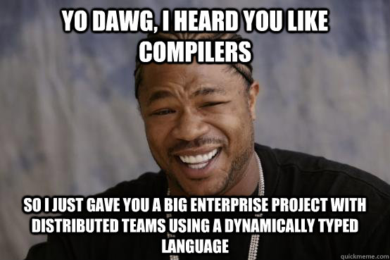
Big teams, big codebases
Notes:
There is no substitute for a compiler
No proven success of Node.js applications in the enterprise world, yet

Slide 37






Where does it run?

Slide 38
Is it commercially supported?
Joyent is the corporate steward of Node.js, the world’s best runtime for today's data-intensive, real-time applications. Joyent offers exclusive debugging and performance analysis tools for Node.js applications.

Slide 39




Anybody using it?

